Slide 1



iJunction : Apple Tech Roundtable
Date : 20th March 2024

Slide 2
iJunction : Apple Tech Roundtable
Date : 20th March 2024

Slide 3

Agenda
Discover MacAdmins India
Apple Mac Monthly Update
Tool Talk
Mac Admins Connect : Open Forum

Slide 4

MacAdmins India: A Community Overview
Established: 2009 with the purpose to fortify the network of Apple device managers in India.
Platforms: Engage with us on various platforms like Telegram, LinkedIn, Slack, YouTube, JAMF Nation User Group.
Mission: To create a supportive and informative ecosystem for individuals responsible for managing Apple devices in India

Slide 5
Mac Admins India
Established: 2009 with the purpose to fortify the network of Apple device managers in India.
Platforms: Engage with us on various platforms like Telegram, LinkedIn, Slack, YouTube, JAMF Nation User Group.
Mission: To create a supportive and informative ecosystem for individuals responsible for managing Apple devices in India.
Notes:
Mac Admins India is a community of individuals who are responsible for supporting and managing Apple devices in India. Formed in 2009, it is available on multiple platforms including Telegram, LinkedIn, Jamf Community and a website. The objective of Mac Admins India is to advance and strengthen the community of individuals in India who are responsible for supporting and managing Apple devices. It provides a forum to share knowledge, tools and best practices among its members.

Slide 6

Our Presence Online
Mac Admins India's website, a central hub for all our events and resources.
Our Slack community, a platform for networking and discussions.
Our YouTube channel, a repository for all our webinars and event recordings.
Our LinkedIn page, where we share updates and news about our community.
A QR code to access information about all these platforms.
Notes:
Mac Admins India has a strong online presence across various platforms, including our website, Slack community, YouTube channel, and LinkedIn page. These platforms serve as a hub for networking, discussions, and sharing valuable resources and information. The QR code provided can be scanned to access all the necessary information about each of these platforms.

Slide 7
Join us here
Scan this QR code to join our community
Notes:
Scan the QR code to join our community where you can engage with us on various platforms like Telegram, LinkedIn, the Jamf Community, and our dedicated website. We offer a space to exchange knowledge, tools, and best practices among peers. Join us in shaping the future of Apple device management in India.

Slide 8

Apple Mac Monthly Update

Slide 9

Apple Introduces New 13" and 15" MacBook Air Models Featuring the Potent M3 Chip.

Slide 10
Apple Security updates
Name and information link | Available for | Release date
GarageBand 10.4.11 | macOS Ventura and macOS Sonoma | 12 Mar 2024
Safari 17.4 | macOS Monterey and macOS Ventura | 07 Mar 2024
macOS Sonoma 14.4 | macOS Sonoma | 07 Mar 2024
macOS Ventura 13.6.5 | macOS Ventura | 07 Mar 2024
macOS Monterey 12.7.4 | macOS Monterey | 07 Mar 2024
watchOS 10.4 | Apple Watch Series 4 and later | 07 Mar 2024
tvOS 17.4 | Apple TV HD and Apple TV 4K (all models) | 07 Mar 2024
visionOS 1.1 | Apple Vision Pro | 07 Mar 2024
Xcode 15.3 | macOS Sonoma 14 and later | 05 Mar 2024
iOS 17.4 and iPadOS 17.4 | iPhone XS and later, iPad Pro 12.9-inch 2nd generation and later, iPad Pro 10.5-inch, iPad Pro 11-inch 1st generation and later, iPad Air 3rd generation and later, iPad 6th generation and later, and iPad mini 5th generation and later | 05 Mar 2024
iOS 16.7.6 and iPadOS 16.7.6 | iPhone 8, iPhone 8 Plus, iPhone X, iPad 5th generation, iPad Pro 9.7-inch, and iPad Pro 12.9-inch 1st generation | 05 Mar 2024

Slide 11
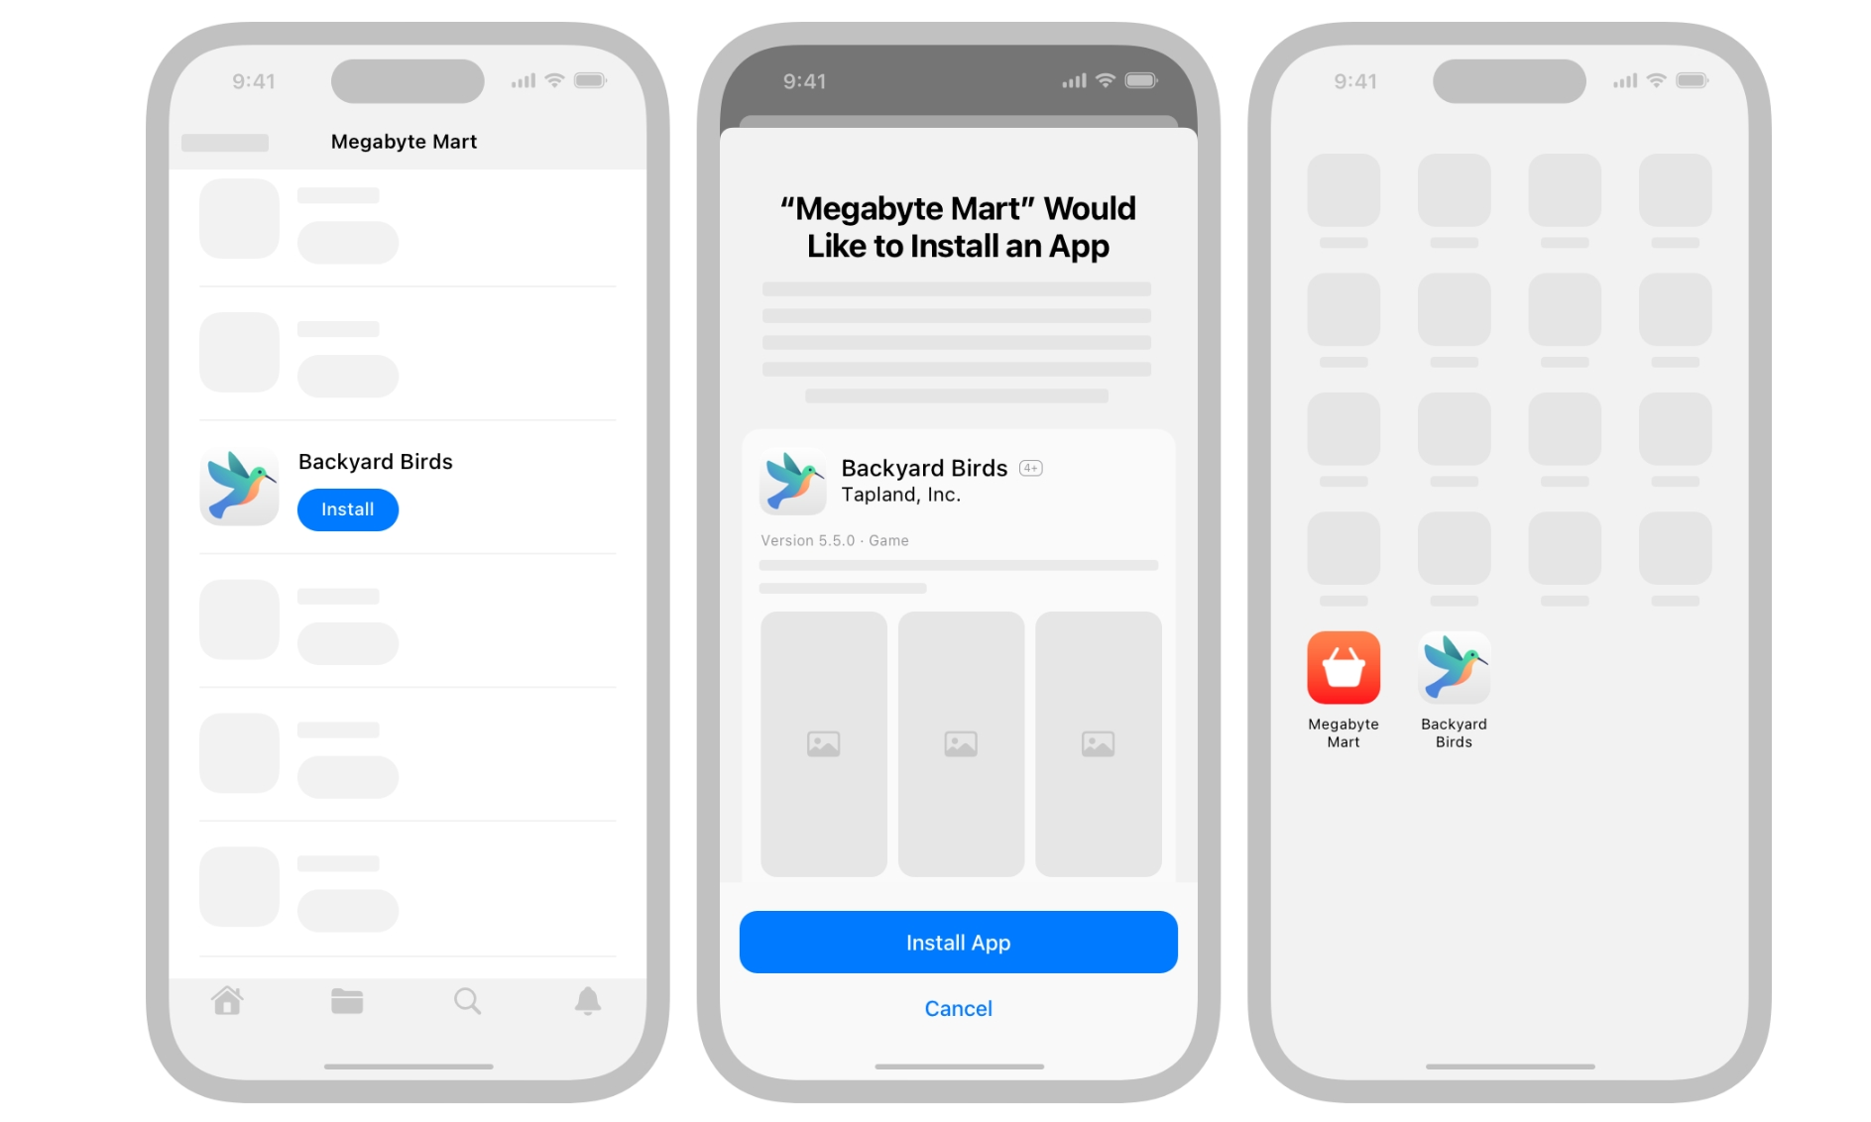
What’s New on iOS 17.4
Alternative app marketplace (EU)
Third-Party Browser Updates (EU)
Full Transcript arrives on Apple Podcast

Slide 12

What’s New on macOS 14.4
MDM can now enforce FileVault for standard users at Setup Assistant & report battery health
Users are no longer prompted a second time for certificate trust after joining an 802.1X network during Setup Assistant.
Installing a software update declaration now overwrites previously installed declarations for the same OS version.
Registration for Platform SSO is now performed without user interaction after creating a new user at login.
Apple has deprecated support for launchctl kickstart

Slide 13

What's New on JAMF Pro 11.3
Account-Driven Device Enrollment
Viewing LAPS Passwords in the JAMF Pro Interface
JAMF Pro Summary Submission Changes
JAMF Admin will be deprecated on 19th March 2024
Alternative to JAMF Admin, JAMF Sync JAMF Printer Manager, JAMF Action will be available with 11.4
JAMF Pro Classic API Basic Authentication will be deprecated at End of March
Notes:
JAMF Pro 11.3 introduces several new features. One of the most notable is Account-Driven Device Enrollment, which allows IT admins to preset device configuration settings for users before deploying devices. Additionally, JAMF Pro 11.3 allows for easier viewing of LAPS passwords in the JAMF Pro interface and makes significant updates to the JAMF Pro summary submission process. IT admins should note that JAMF Admin will be deprecated on 19th March 2024. Fortunately, there are several alternative options such as JAMF Sync Jamf Printer Manager, JAMF Action. Overall, this update provides great benefits to IT admins and users alike, making device management even easier and more secure than ever before.

Slide 14

What's New on Kandji
Kandji's Integration with ServiceNow is Live

Slide 15

CVE-2024-27301 Zsh
The Nudge and Support app have identified with Zsh Root Escalation Vulnerability
Latest Version was released to fix those updates
Any scripts with #!/bin/zsh is affected,
Replace #!/bin/zsh With #!/bin/zsh --no-rcs
Update Nudge and Support app to the latest version
Installomator will release an update soon.

Slide 16

Tool Talk

Slide 17

Network Quality Command
Test networks with Apple Network Responsiveness
The macOS networkquality command takes Apple CDN as a target to measure the items below.
Upload/download capacity
Upload/download flows
Upload/download responsiveness is measured in RPM.
networkQuality tests the upload/download capacity and responsiveness in parallel by default.
Notes:
(Roundtrips Per Minute), which is the number of sequential round-trips, or transactions, that a network can do in one minute under normal working conditions
(which refers to the number of test packets used for the responsiveness tests)

Slide 18


